Slide 1

CLIQUE – Experience Luxury At Convenience

Slide 2








WAIŪ : Mission, Vision & Values
Mission:
To create a global service provider of hospitality industry, realizing pioneering advancements in established services and accomplish mutual growth for both our partners & customers
Vision:
WAIŪ is dedicated to provide modern & innovative solutions to our hospitality partners, via introduction of technology evolution in their offerings and creating avenues of inspiring new business horizons.
Values:
Innovation through Leadership : To become vanguard of hospitality experience enrichment
Modernization & Elegance : To develop ultramodern hospitality business solutions
Focus & Evolution : Relentlessly strive to improve business value through performance

Slide 3
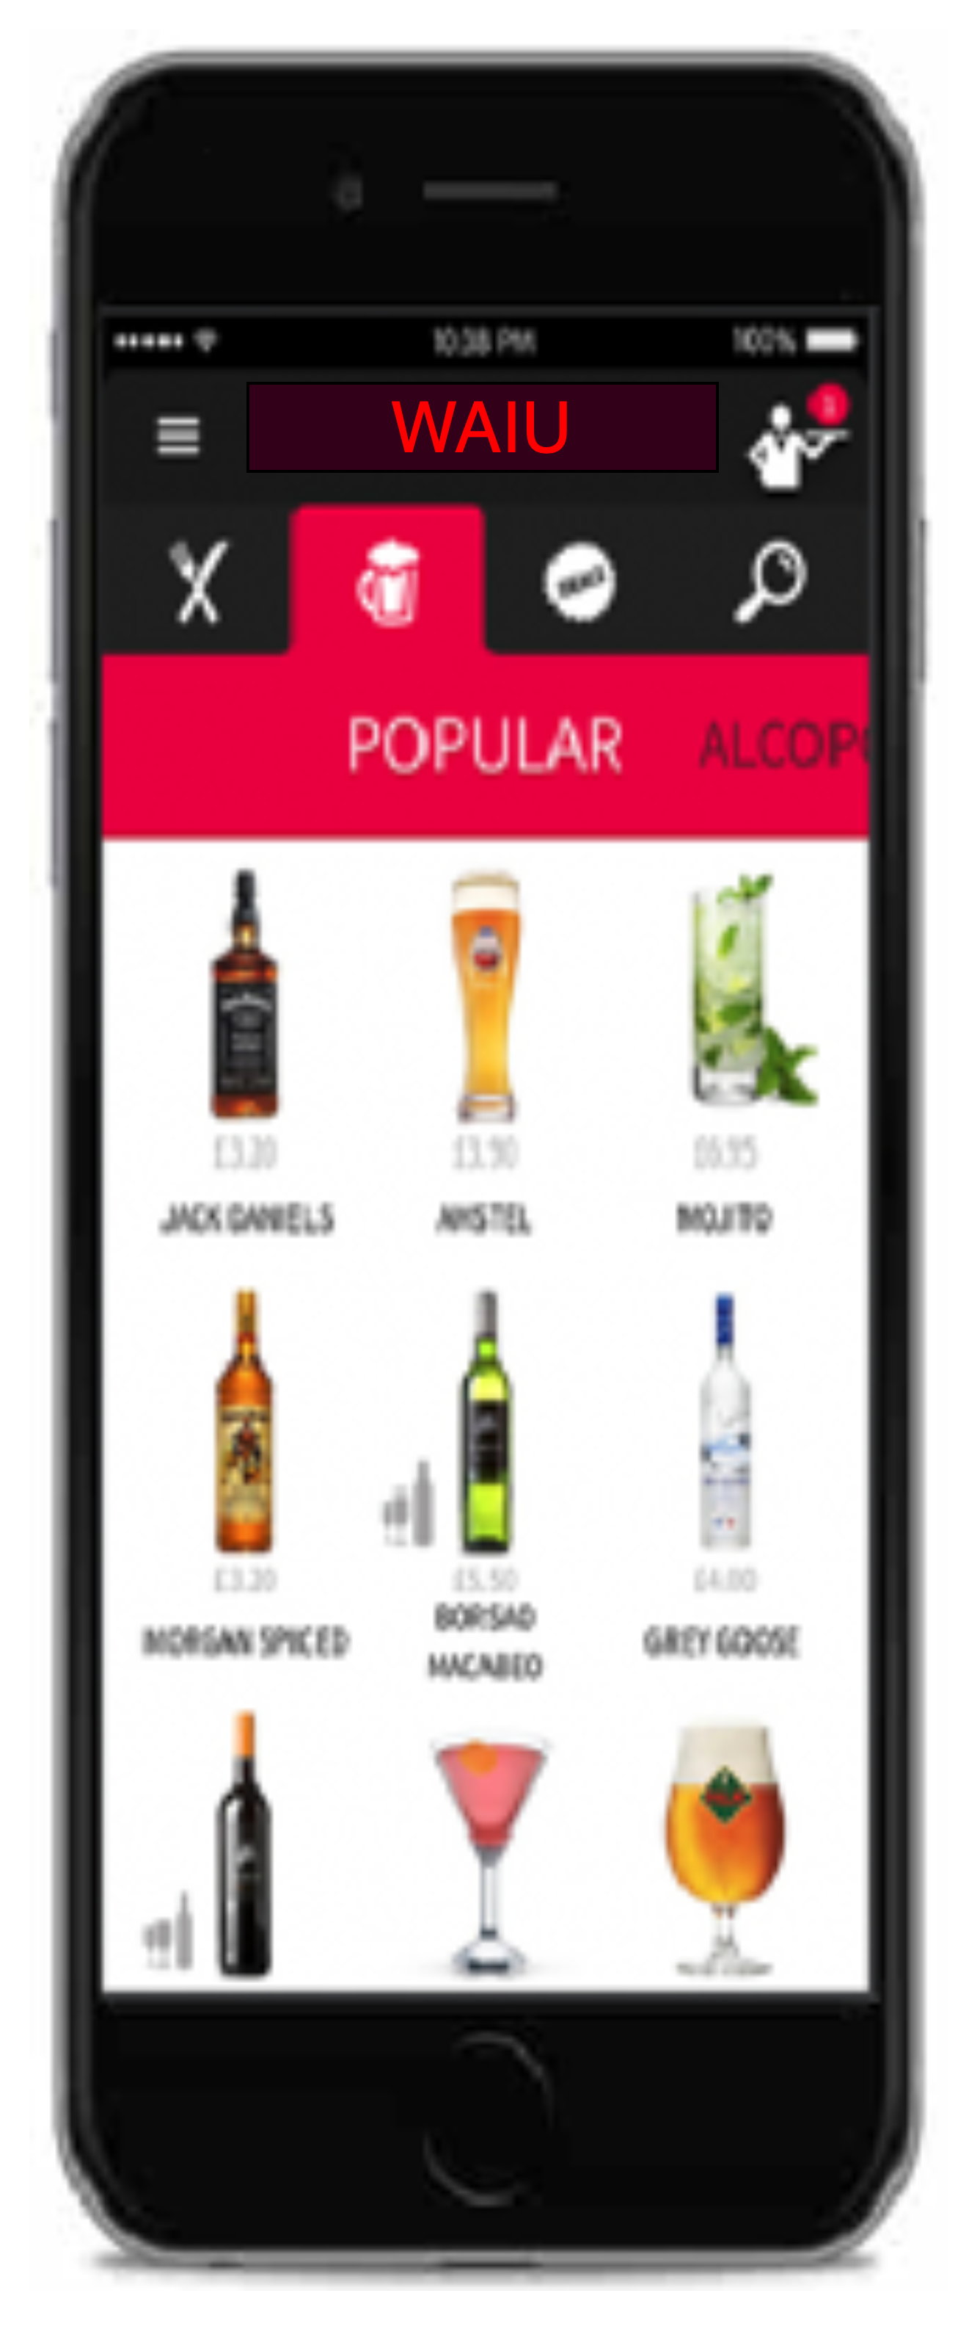








WAIŪ : Product & Features
F&B Services
Instant cashback facility for regular customers to avail restaurant services
Broadcast & Live Streaming
Watch exclusive live shows of your favorite artists & performers
Gift a Friend
Gift or share an item of choice to your beloved ones – Family & Friends, Colleagues, Corporates
Logistics & Governance
Reduced expenses through aggregator independence, merchant governance support & staff training
Offer a New Friend
Offer service will be availed at merchant establishment with other groups or individuals
Events & Gaming
Promote corporate events, interactive games for in-house patrons
Payments & PBS
Express true feeling of sharing & gifting with points instead of money
Clique - Dine Now, Pay Later
Privileged credit services for the our NBFC/MFI partner’s customers

Slide 4



Clique – An Opportunity under Truevibez Umbrella
Clique is premium service offered to our finest customers & business partners, to mutually benefit through means of microfinancing services.
Dine Now, Pay Later
For customer expecting an event to visit restaurant but without available liquid funding, Clique will open up a line of credit in handshake with a lender (NBFC). The customer can request this restaurant-focused credit line and once approved, use it at any partner restaurant.
Merchant Staff Financial Lending
Restaurant staff currently face many challenges in requesting loans from banks and NBFCs however from recommendation of a partner merchants, a low-medium size credit pool will be made available to them with flexible repayment options.
With microfinance market anticipated to grow with CAGR of 40% through 2025, NBFC-MFIs will be its greatest beneficiaries. In F&B segment, unbanked microlending has only reached 12-15% of the prospective market.

Slide 5
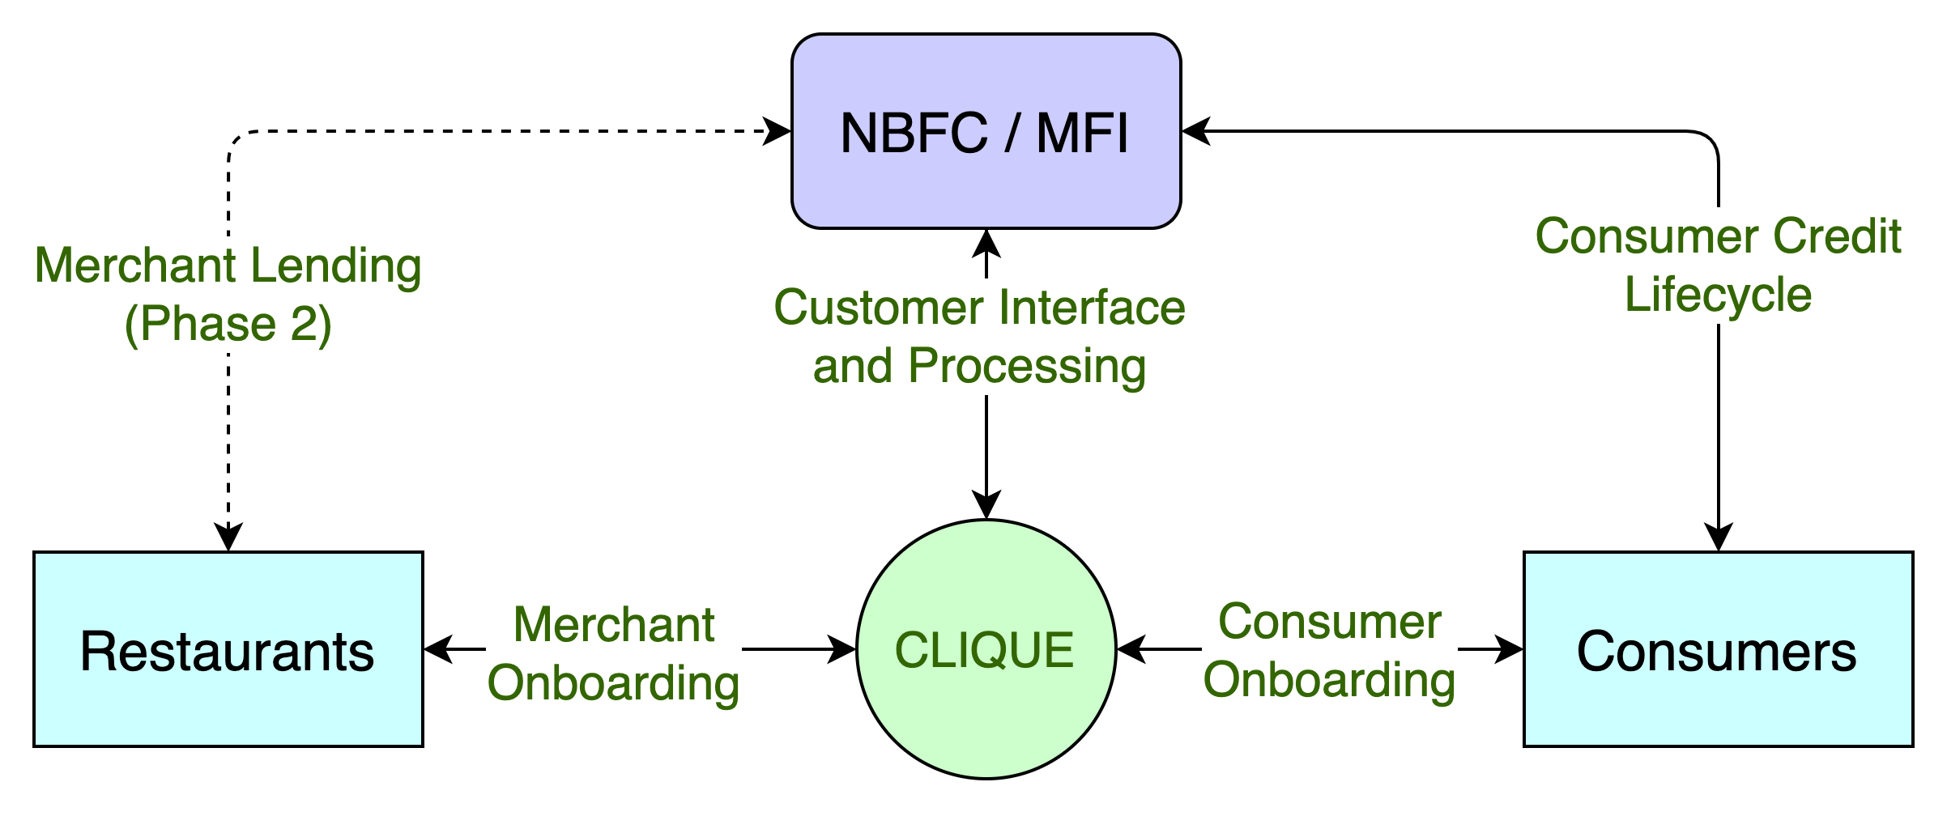
Clique – High Level System Flow
CASE STUDIES
Zomato, in partnership with InCred, to lend Rs 1L to 50k restaurants, developing loan book of 500CR
PAYO (Australia) – Launched ENPL service in July-21 & already has 500+ restaurant partners

Slide 6
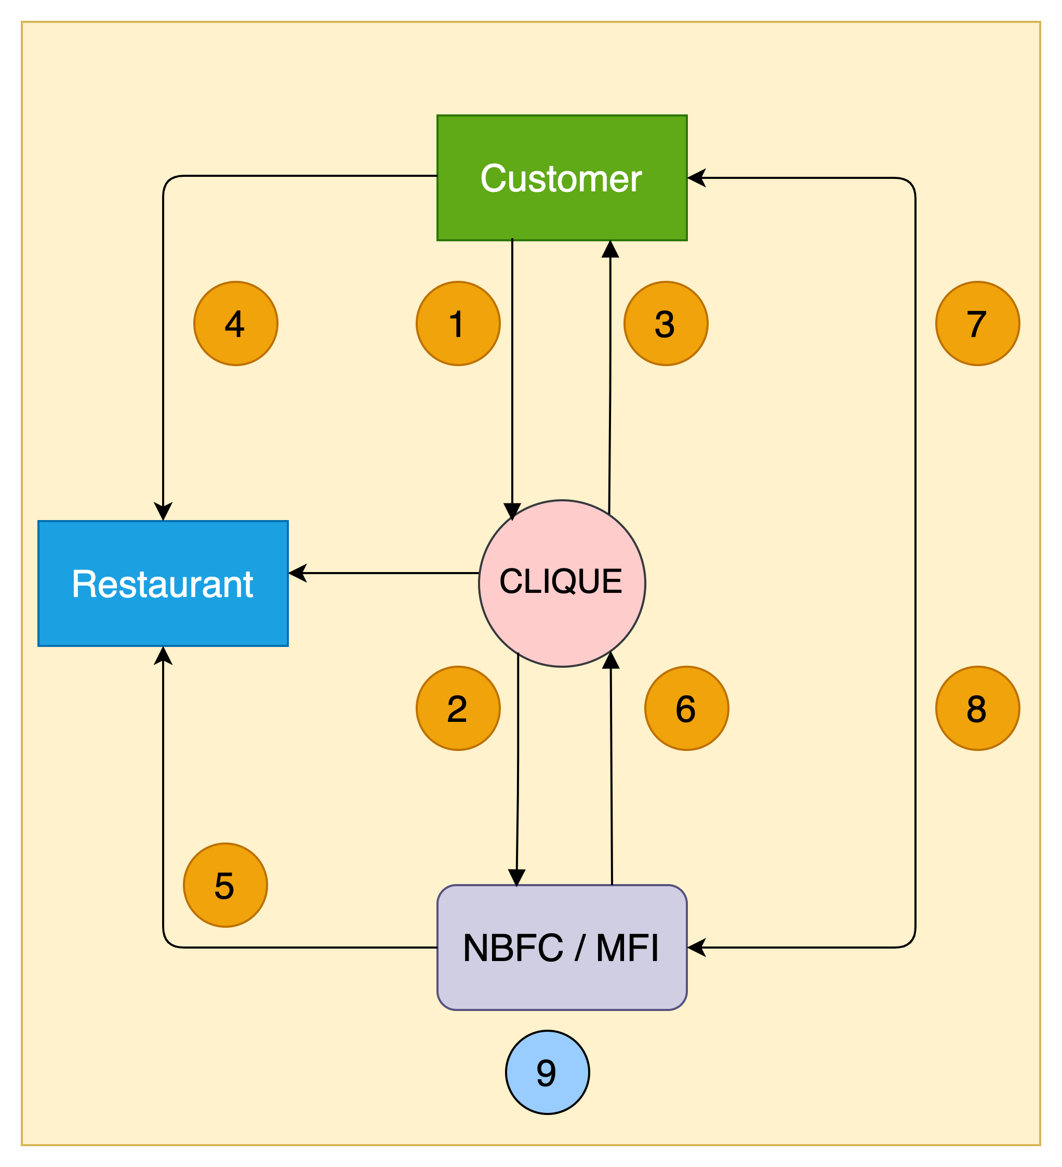
Clique – High Level Transaction Process Flow
1. Customer walks into a restaurant & applies for the wallet credit through Clique App
2. Clique receives customer application & send it to the lender for underwriting & respond with approval or rejection
3. Customer app wallet is credited with approved funds & signs NACH mandate
4. Customer utilises the wallet credit at the restaurant e.g., Rs 5000
5. Lender pays the merchant (less the operational charges) based on merchant's billing cycle e.g., Rs 4000
6. Lender pay the commission to Clique e.g., Rs 800 based on payment reconciliation, on agreed frequency
7. Customer pays lender later based on agreed T&C,
including interests, delay charges etc.
8. Once paid, even if partially, lender updates Clique to reset
customer’s wallet for calculated funds for further utilisation
9. Lender keeps the balance i.e., Rs 200, for their services

Slide 7
Clique – Customer Onboarding Journey
02
Customer reviews standees, flyers, tent cards and informed by staff about Clique
03
Customer downloads Clique app and completes KYC application
01
Customer walks into
a restaurant
Clique routes the application to lender
06
Lender sends a confirmation back to Clique
04
05
Lender underwrites the customer
07
Clique updates customer app and reflects the wallet credits
08
Customer enjoys the F&B services
09
Customer pays through clique credit & returns home

Slide 8
Merchant – Engagement & Growth
Surge
Grow
Retain
Deploy
Attract
Engage
Relate
Identify Key Concerns
Show Importance
Reflect Passion
Media Interaction
Uncover Strategy
Unveil Edge
Compare Results
Events
Interaction
Awards
Felicitation
Awareness
Collaboration
Customer Care
Clique Pilot
POC / Beta
Clique Launch
Full Service
Governance
Value Adds
Ease of Business
Business Boost
Referrals
Engagement
Statistics & Analytics
Product Placement
Features services
Volume Boost
Upselling
Cross Move
Up-cycling
Dynamic Pricing
Scoring / Rating
Feedback
WAIU Launch
Added Products
Promote
Memberships
Customer engagement
Logistics
Governance

Slide 9
Merchant – Elevated Pitch
Increased Profit Margins
Of restaurants by onboarding brand new customers & rotate existing customer more often
Cross Industry Alliance
Merchants to benefit from Clique partnerships like Pune Mirror, Sakal, Banks & Lenders
New Product & Features
To be offered to customers for extended loyalty & addition premium clientele
Larger Ticket Size
Eat Now Pay Later customers to spend an average of 15-30% higher on F&B services
High Customer Retention
To continue their quality service & more to existing customers without any additional expense
Merchant, Staff & Consumer Lending
To support merchant financial needs without bank audit & documentations

Slide 10
Customer – Elevated Pitch
New Product & Features
Credit line facility for F&B services during need and additional guaranteed benefits of dining out
New Borrowing Avenue
By utilizing existing relationships and financial network portfolio in an organized & professional manner
Bio-Authorization For Enhanced Safety
Reactive Credit Scoring
To allow customers to increase credit line for more benefits & increased financial literacy
Best Rates & Flexible Terms
With long risk-free no-interest paying term, along with a range of payment plans at offer with different lenders to choose from
No Fees & Ease of Use
Simple to use service without any hidden costs, allowing decorum & savings
On Demand Spending Potential
No more dependency on regular cash flows & a flexible solution for all occasions combined with increased risk-free spending potential

Slide 11
Merchant Acquisition Strategy
Awareness
Sales pitch to restaurant owners & Customer support services
Promotions
TVC, Radio, Contact Center, Video Adverts to be carried out both locally & nationally and celebrity tie-ups
Advocacy & Support
Flexible model for adaptive service staff lending & attracting attention with customer support
Merchant
Acquisition
Events & Endorsements
Promotional programs & felicitation by prominent leaders & industry savants
S2B/S2C Networking
Staff Boost, Bloggers meet & Digital campaigns, Standees/Tent cards, Staff boost, Web Promotions
Merchant
Development
Value
Demonstration of restaurant scale- based growth pattern & restaurant reduction in advances/credits
Partnerships & Affiliations
TOI Felicitation, Print Media, Lender’s internal publicity, NPCI onboarding, Restaurant association tie-ups

Slide 12
Clique – 360° Benefits
Eat now, Pay Later
Consumers | Restaurants | MFI-NBFC
Increase in spend potential | Increased sales | New customers
Bio-authorization to reduce risks | Higher ticket size | Increased presence
No joining or renewal fees | New feature to offer | Competitive edge
Decorum & savings | No additional charges | Innovative offer
Microfinancing
Consumers | Restaurants | MFI-NBFC
Increased borrowing potential | Self-sufficiency at competitive rates | Untapped market – Millennials, Zoomers
Enhanced financial literacy | Standardized & organized system | Inclusive growth
Reactive credit scoring | Reduced regulatory challenges | Valued partnership
Better rates than banks | Co-branding opportunities | Benefit from geographic expansions

Slide 13
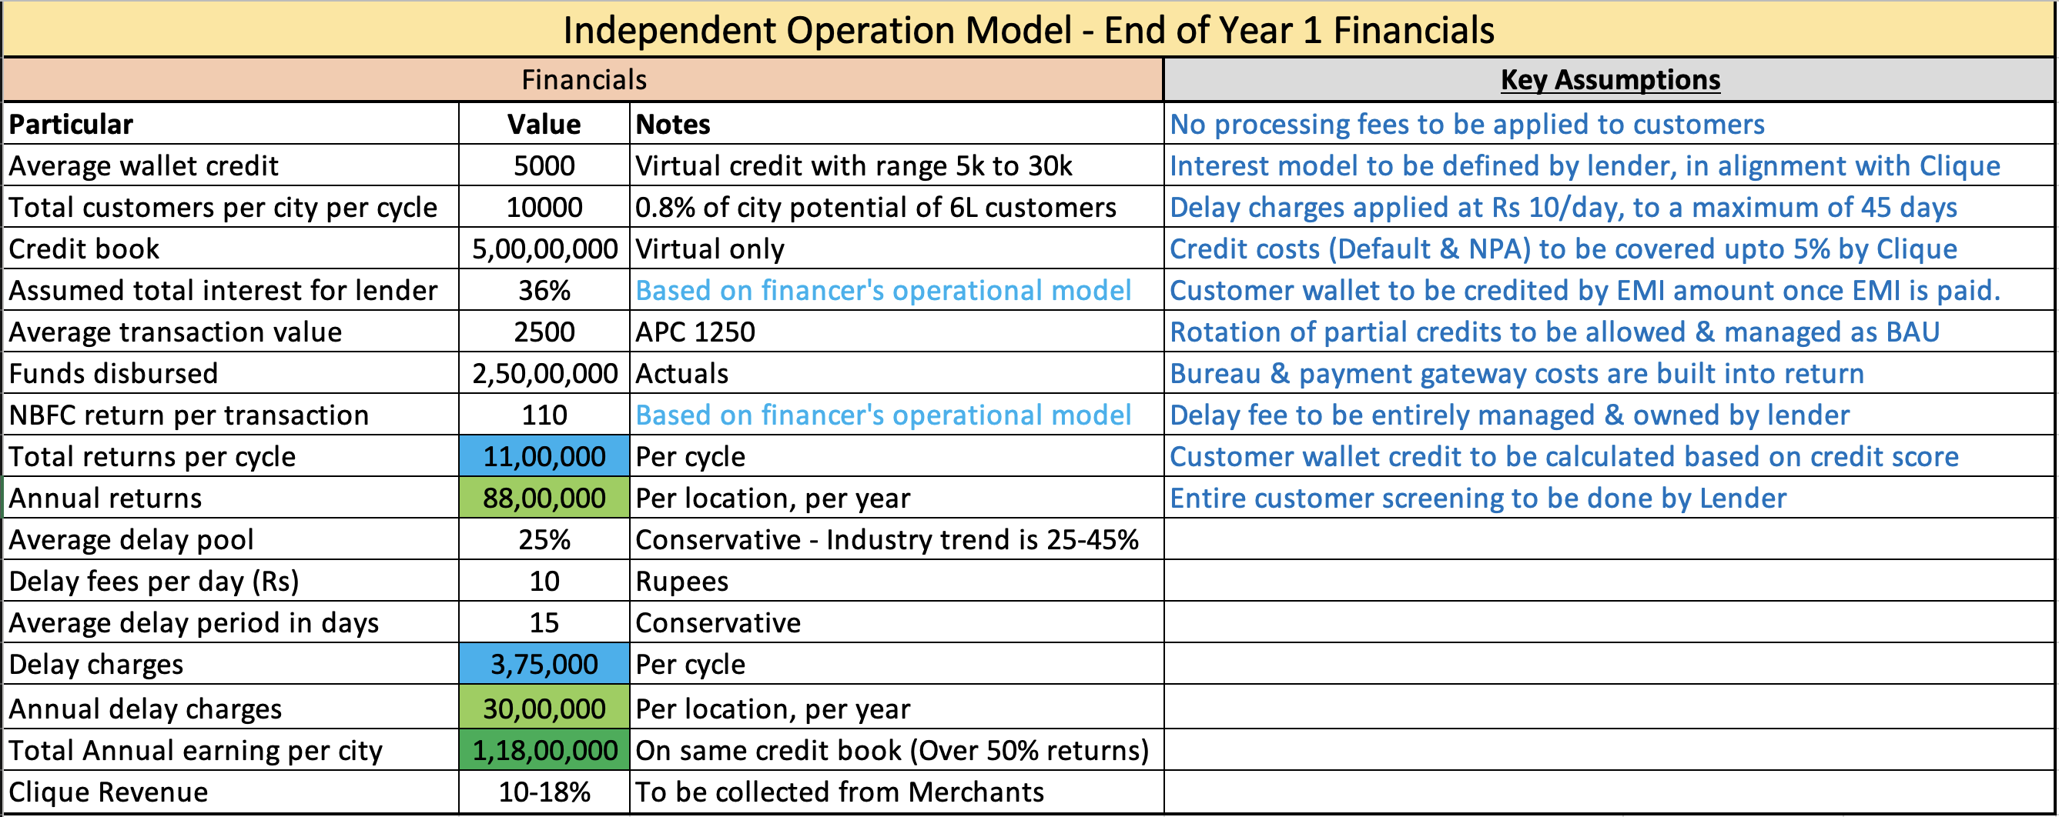
Clique – Independent Operations Model – EOY Cycle

Slide 14
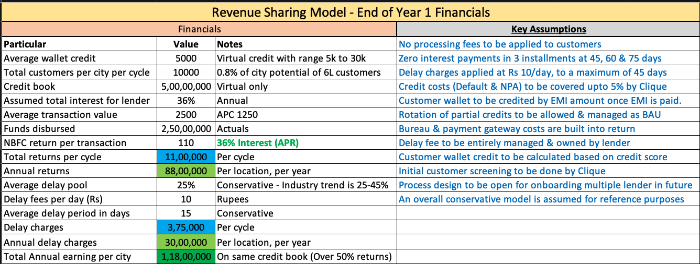
Clique – Revenue Sharing Model – EOY Cycle

Slide 15
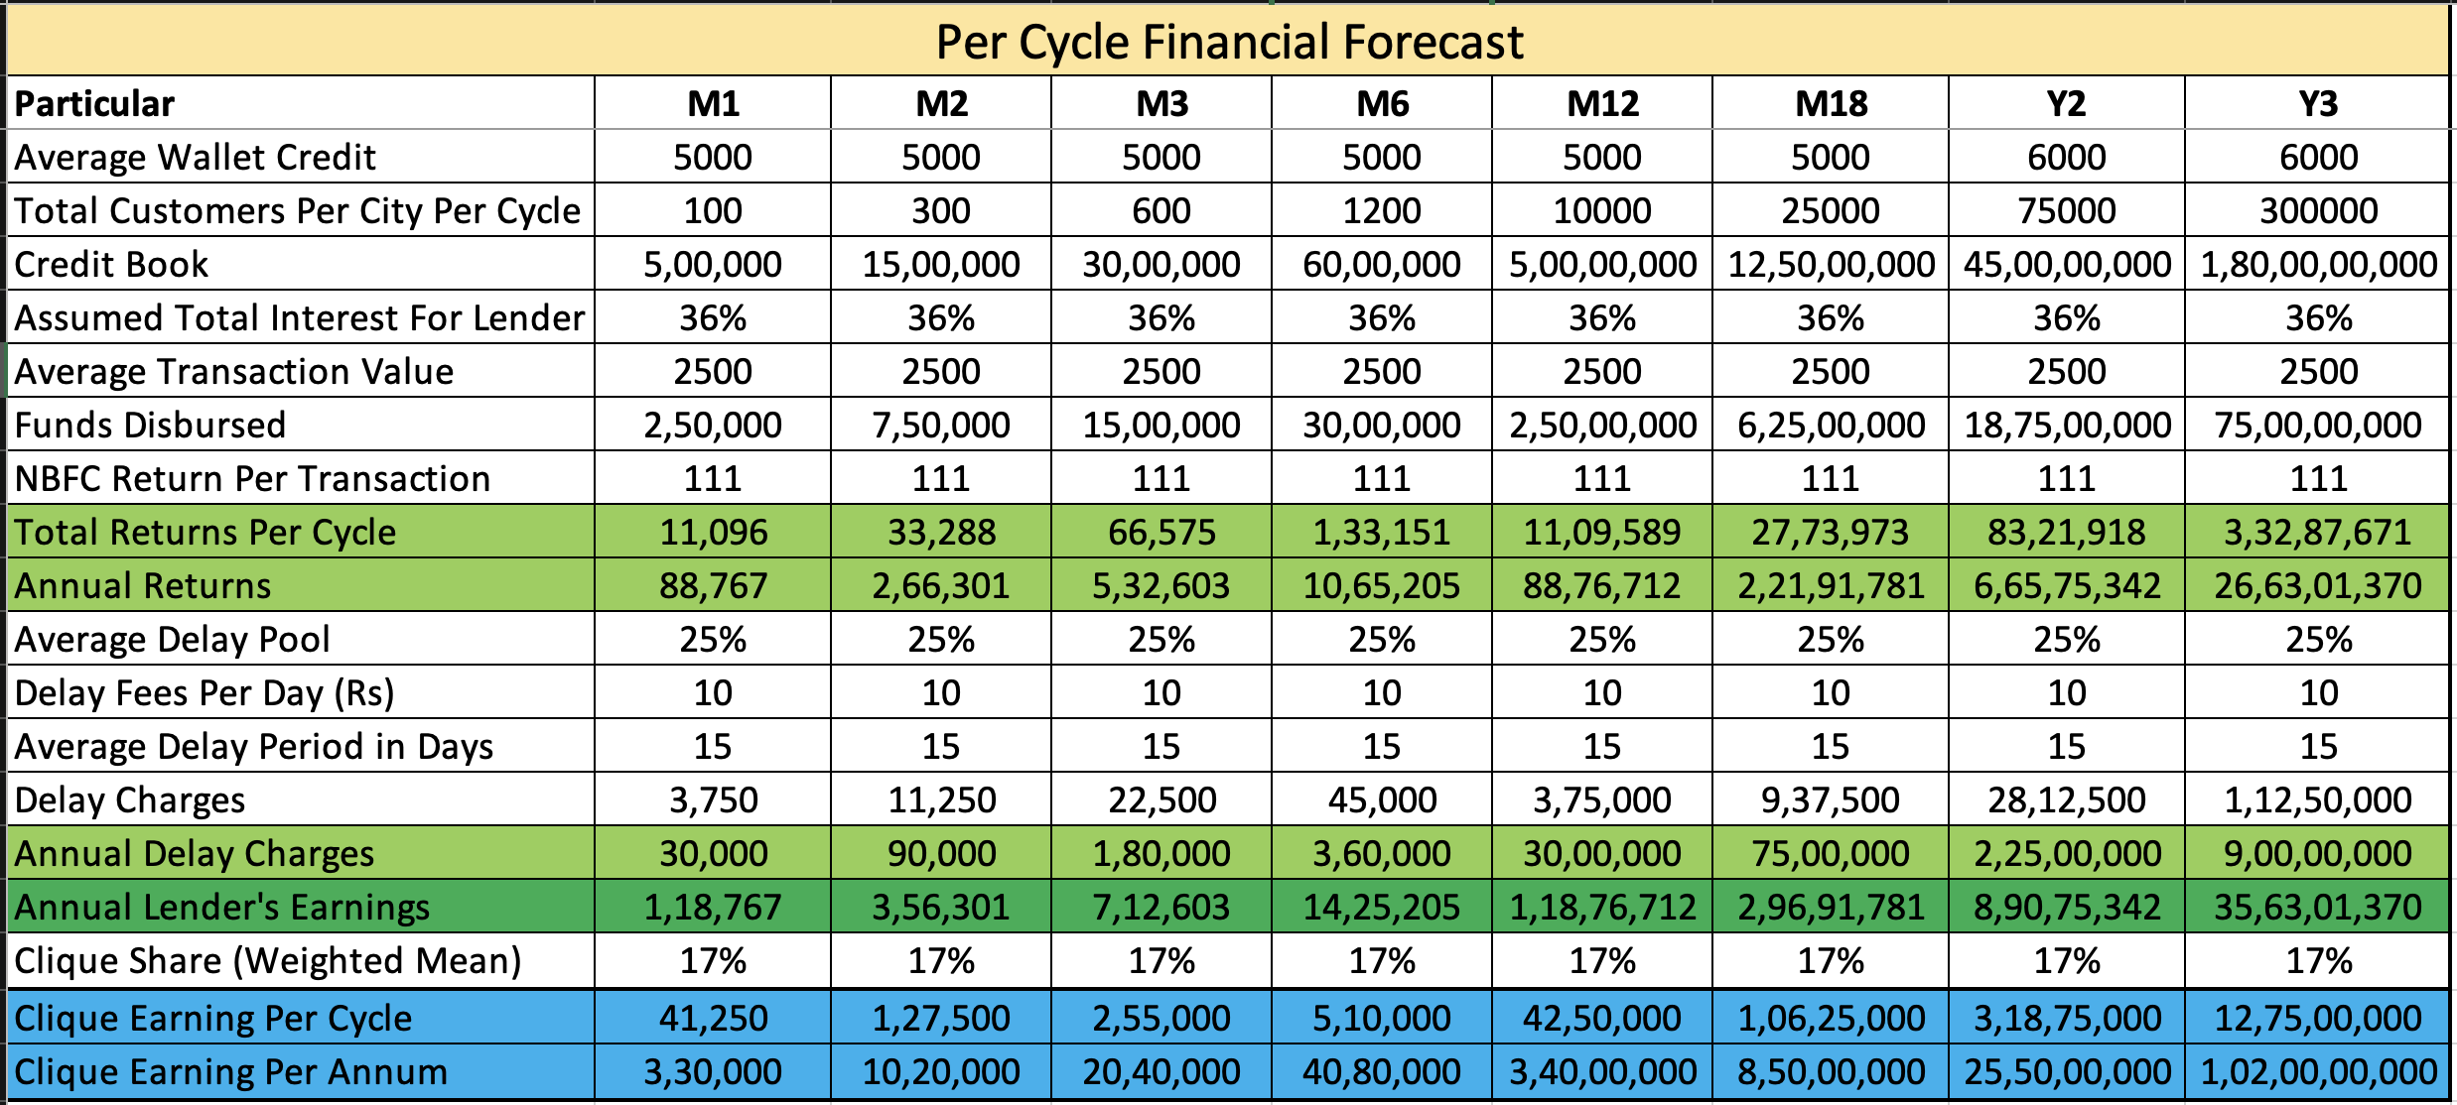
Clique: Financial Forecast – 5 Years
Notes
Conservative assumption that 2nd cycle to start only when 1st on is complete

Slide 16
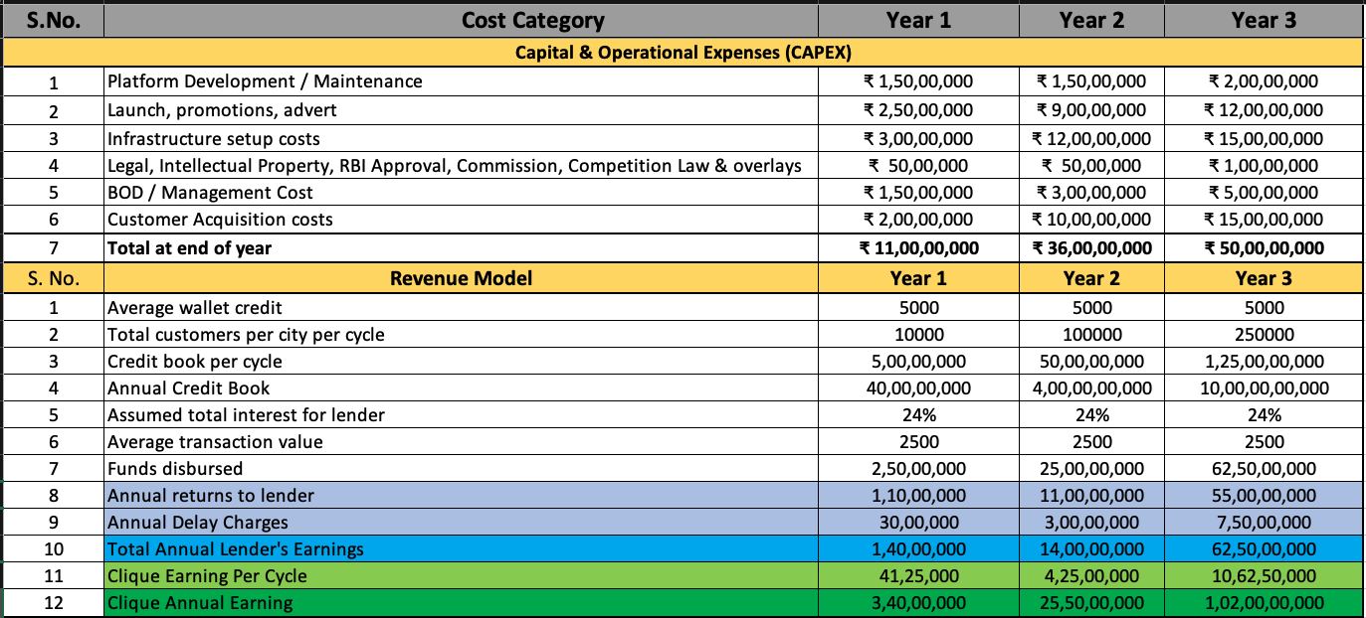
Clique – Revenue & Expenses

Slide 17
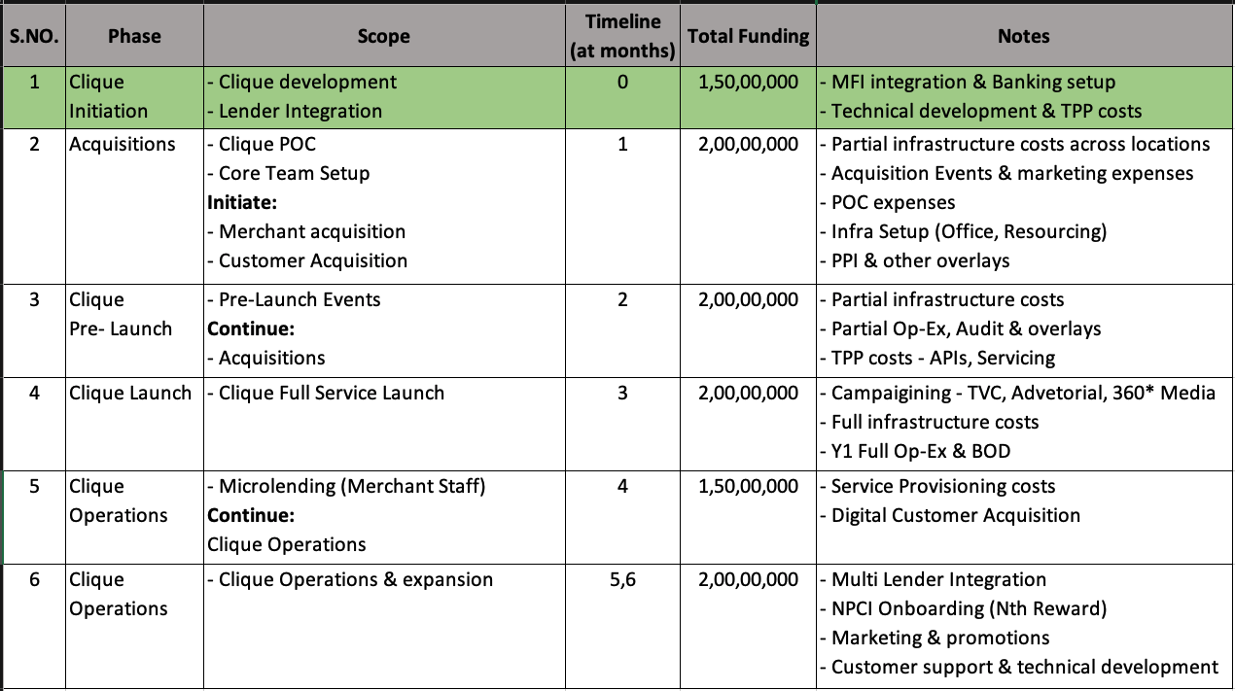
Clique – Phase Costing – Year 1

Slide 18







PAYO (Australia) – A case study
About PAYO
PAYO is an Australian company who have launched the world’s first Eat Now, Pay Later service in July 2021.
The are backed by an existing lender with substantial customer base in the operational regions.
Being the World’s first ENPL app, they have favorably placed themselves as market disrupters, driving investor’s interest & confidence.
Within 3 months of launch, 700+ merchants in 4 cities & growing at the pace of 200 merchants every month
All payments are divided across 4 interest free EMIs, with only a quarter of payment to be made upfront.
Top performing 50 restaurants have received thousands of transactions with recorded order value increase of 60%
Diners can discover restaurants, filter by preferences, call restaurant, book table and receive range of offers & deals.
Both restaurants & customers are incentivized for referring more paying users to the platform
All payments are via PAYO app via QR codes with options for customer to recommend for PAYO business
Instant approval & discreet process has given PAYO an edge over other modes of payments, eliminating need to carry wallets

Slide 19
Customer Acquisition Strategy
Merchant Acquisition Strategy | Consumer Acquisition Strategy | Notes
Direct sales via dedicated regional teams (10 per location per month) | WAIU direct acquisition (6-8k per location per month) | WAIU service acquisitions
Corporate collaborations with multi-location hospitality brands | Aggregation based model to increase time to market | To enable increased time to market
Pre/Post launch promotional & marketing campaigns | Social media & network advertisements | Combination of digital & traditional strategies
Network tie-ups and contact center for customer servicing | Event tie-ups e.g., Ridermania, Ruggedian

Slide 20
Case Studies
Company / Particular | Dineout | Magicpin | Eazydiner | Devourin
Founded | 2012, Noida | 2015, Gurgaon | 2014, Delhi | 2015, Pune
Owner | Times | Self | Self | Self
Services | Booking, Rewards, Payments, Artists | Discovery, Rewards | Discovery, Payment, Rewards | POS, SCM, Data Analytics, CRM
Coverage | 20 Cities | 40 Cities | 150 Cities | 2 Cities
Acquisition Restaurant / Customers | 50K / 2.5CR | 1.5L / 50L | 10K / 30L | 200 / None
Investments | $100MN (2019) | $43M (2021) | $16M (2020) | $150K (2016)
Revenue | $200M | $10M | $42M | $500K
YoY Growth | 154% (2019) | 415% (2018) | 400% (2019) | TBC
Valuation | TBC | $165M | $40M | $1M

Slide 21
Project Plan – 6 Phased
Phase 06
Q3 2024
Expand in existing 7 Cities & explore additional scope
Target 2400 Restaurants & 3 Lacs Customers per city
3600 FL3
36Lacs FL4
3000 FL3
30 Lacs FL4
Phase 05
Q1 2024
Expand in existing 7 Cities & explore additional scope
Target 2000 Restaurants & 1.5 Lacs Customers per city
Phase 04
Q3 2023
Expand in existing 7 Cities & explore additional scope
Target 1600 Restaurants & 75K Customers per city
2400 FL3
24 Lacs FL4
1800 FL3
18 Lacs FL4
Phase 03
Q1 2023
Expand in existing 7 Cities & explore additional scope
Target 1200 Restaurants & 25K Customers per city
Phase 02
Q3 2022
Expand in existing 7 Cities & explore additional scope
Target 800 Restaurants & 10k Customers per city
1200 FL3
12Lacs FL4
Phase 01
Q1 2022
Launch in 7 Cities
Target 400 Restaurants & 1200 Customers per city
Company Registration : July 2020 - Complete
MVP PoC : Dec 2021
Foundation Period : Q1 2022
Launch : Q1 2022

Slide 22
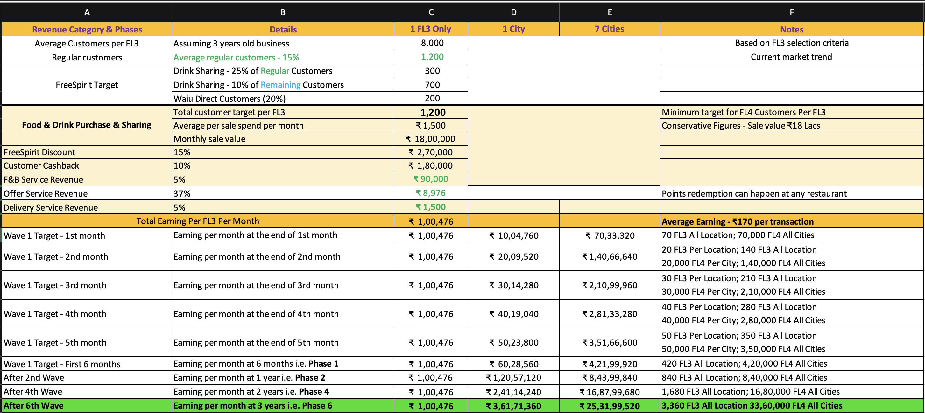
WAIU - Revenue Model

Slide 23
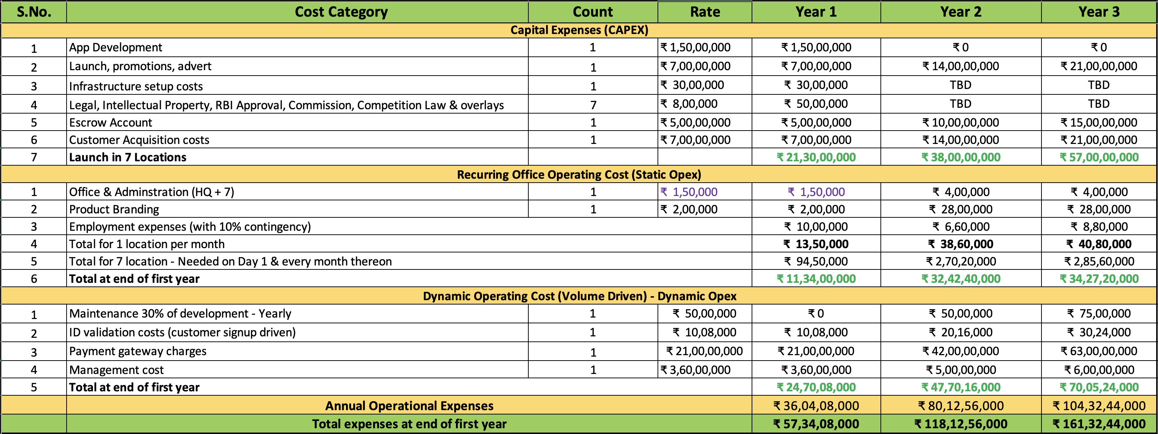
WAIU - Capital Investment & Operational Expenditure

Slide 24
Our Team
Promoters
Rajesh Karandikar
Alok Sambuddha
Board Of Advisors
Suhas Gokhale : Managing Director, COSMOS Bank, Pune
Rahul Renavikar :Managing Director, Acuris Advisors (GST & Government Policies) – Ex. Big 4 & Tata Motors
Chetan Oswal : Accounts & Legal Counsel
Shrikant Chatur; Governance Consultant (ex. VP Commercial - Cummins)
Sanjay Phadke : Fintech Specialist, Ex. EVP Edelweiss & Vayana Network, JP Morgan, HSBC
Rakesh Malhotra : Media Curator, Ex. Media Head - Sakal
Yogesh Katre : Sales Head, Loantap
Harun Rashid Khan : Regulatory Advisor, Ex. Deputy Governor RBI
Vinay Baijal : Regulatory Advisor, Ex. CGM Banking, RBI

Slide 25
Corporate Partnership
S. No. | Partner | Role
1 | NPCI | Nth Reward Loyalty platform onboarding & campaigning platform
2 | Cosmos Bank | Value add service to bank customers via bank's super-app
3 | KPMG | RBI regulatory compliance and licensing services
4 | Bajaj Finserv | Financial lending service provider
5 | Payu Finance (Lazypay) | Financial lending service provider
6 | Paytm | Financial lending service provider
7 | Early Salary | Financial lending service provider
8 | LoanTap | Financial lending service provider
9 | Michael Dell Foundation | Financial lending service provider
10 | Suniel Shetty (Popcorn Entertainment) | Brand Ambassador
11 | TOI, Pune Mirror | Media & Advertorials
12 | SonyLiv | Entertainment and broadcast services
13 | Stratacache (SCALA) | Broadcast infrastructure and CDN
14 | Sazinga Digital | Technical platform development & maintenance

Slide 26






Question & Answers

